Slide 1
CSE 2102: Introduction to Software Engineering
Software Engineering Principles
Rigor & Formality, Separation of Concerns

Slide 2
What is a Principle?
A principle is a fundamental value that guides a process.
  Every field follows its own set of principles.
Objective is to bring predictability to the process, and comparison among different organizations.
For example, what are the goals of accounting principles?
  To produce timely and comparable financial reports.
What are the goals of software engineering principles?

Slide 3
Why are SE Principles Needed?
Unique characteristics of target software systems -- necessary to bring oversight to the process.
Users of the system separate from the developers, may be non-computing personnel.
  Misunderstandings about what the technology can accomplish.
Software systems are large, and beyond the comprehension and scope of a single individual.
  Application development has evolved to teams, which brings in issues of coordination and scheduling.
Today’s systems of today are used in many critical domains where the cost and consequences of failures are high.
  Systems have stringent reliability requirements.

Slide 4
Why are SE Principles Needed?
Software systems live much longer than expected, and planned for:
  They must not only be designed and built to satisfy today’s requirements, but rather must be elegantly evolved to meet future expectations.
Many software systems deployed in multiple operating environments
  Members of a product family rather than as an isolated system.

Slide 5
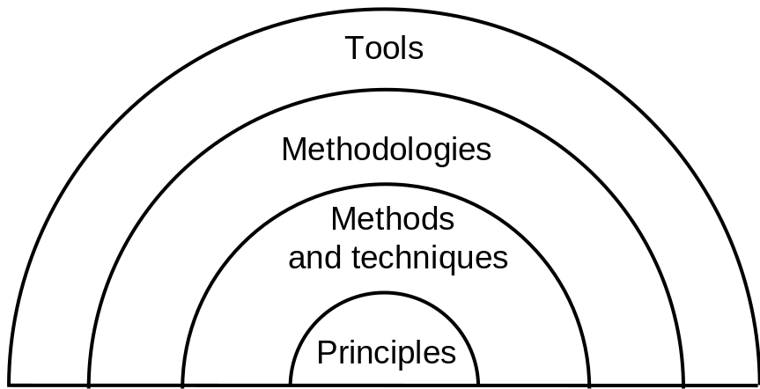
Principles vs. Methods vs. Tools
Principles involve software engineering process and its product. These are abstract statements at a high level that must be followed.
Methods and techniques are systematic, specific approaches to solving a problem by applying the principles.
Principles become practice through methods and techniques.
Methodology consists of organizing methods/techniques into a process that assists in problem solving.
Finally, for a methodology to be widely adopted the techniques and methods composing the methodology must be encapsulated in a friendly, easy to use form. Methodology can be enforced.

Slide 6
Outline
by tools
Seven important principles that may be used in all phases of software development
Modularity is the cornerstone principle supporting software design

Slide 7
Key Principles
Rigor and formality
Separation of concerns
Modularity
Abstraction
Anticipation of change
Generality
Incrementality

Slide 8
Rigor and Formality: Motivation
Problem statement:
Write a program that computes the square root of a number
What is wrong/missing in this simple problem statement?
What is the range of numbers that will be accepted as input?
What is the output of the program if the input number is positive?
- Positive square root, negative square root, or both.
What is the output of the program if the input number is negative?
- Error message, complex root, or both?

Slide 9
Rigor and Formality: Motivation
More rigorous problem statement:
Write a program to compute the square root of a given number. The
program accepts positive and negative numbers as well as zero as
input. If the input is a positive number, then the output should be
both positive and negative square roots of the number. If the input
is zero, then the output should be zero. If the input is a negative
number, then the program should print an error message and exit.
Tries to consider and anticipate all the situations.
Tries to define or specify precisely the behavior for all the situations.
Can you find anything lacking in this problem statement?

Slide 10
Rigor and Formality: Motivation
Formality is rigor at the highest degree.
Use of mathematical equations to specify the behavior
SquareRoot(x)
Output = + sqrt(x), if x > 0
= 0 if x = 0
= “Error” if x < 0
Input x;

Slide 11
Rigor and Formality
Software engineering is a creative design activity
  Creativity leads to imprecision and inaccuracy
Hence, it must be practiced systematically
Rigor is a necessary complement to creativity that increases our confidence in our development
  Rigor is necessary for thoroughness
Formality is rigor at the highest degree, and allows a program to be proven correct.
  Software process driven and evaluated by mathematical laws

Slide 12
Rigor and Formality (contd..)
Software engineers active partners in rigor and formality requirements
Rigor and formality impact across multiple phases of software design process
  Specification vs. Design vs. Implementation
  Maintenance vs. Evolution

Slide 13
Examples of Rigor and Formality
Product:
  Mathematical (formal) analysis of program correctness
  Systematic (rigorous) test data derivation
Process:
  Rigorous documentation of development steps helps project management and assessment of timeliness

Slide 14
Separation of Concerns
Problem statement:
Write a program to compute the square root of a given number. The
program accepts positive and negative numbers as well as zero as
input. If the input is a positive number, then the output should be
both positive and negative square roots of the number. If the input
is zero, then the output should be zero. If the input is negative, the
Program should print an error message. The output should be
produced in 2 ms.
Different concerns:
Functional correctness for positive inputs
Robustness for negative inputs
Performance
Address different concerns separately:
First provide an implementation which is functionally correct.
Exception handling to handle negative inputs.
Replace the simple implementation by an efficient one to improve
performance.

Slide 15
Separation of Concerns
Divide and conquer problem solving techniques
  Understanding dependencies among sub problems
    Which sub problems are (in)dependent?
    Can problem viewed from differing perspectives?
As application’s complexity increases
  Separate concerns
  Compartmentalize towards components
Identify the different aspects of problem
  Time considerations – Scheduling
  Focus on qualities of primary concern
    Address qualities separately for each problem
    Performance vs. Correctness vs. Interoperability
  Alternate views of problem – data vs. control
  Size-oriented decomposition

Slide 16
Separation of Concerns (contd..)
Separation of concerns supports:
  Parallelization of efforts
  Separation of responsibilities
Software applications must be able to exploit hardware advances:
  Faster CPUs, more memory/disk
  Still exceeding workstation “capabilities”
Today’s applications involve interoperability of
  New C/S, Legacy, COTS, Databases, etc.
  Multiple programming languages (C, C++, Java, etc.)
  Heterogeneous hardware/OS platforms
Separation of concerns is critical

Slide 17
Examples
Go through phases one after the other (as in waterfall)
  Separation of concerns by separating activities with respect to time
Keep product requirements separate
  Functionality
  Performance
  User interface and usability

